Slide 1
تمرین هفتم مدار منطقی

Slide 2
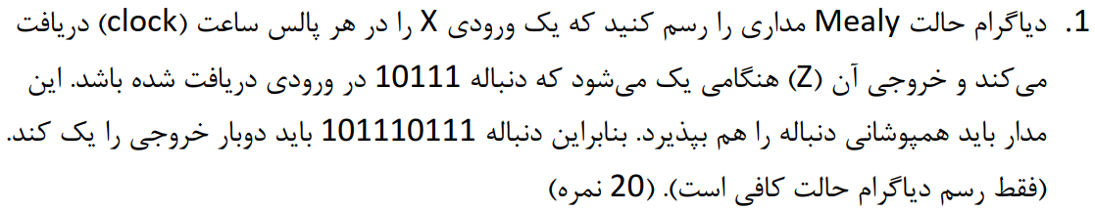



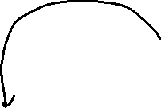

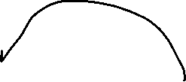


Slide 3
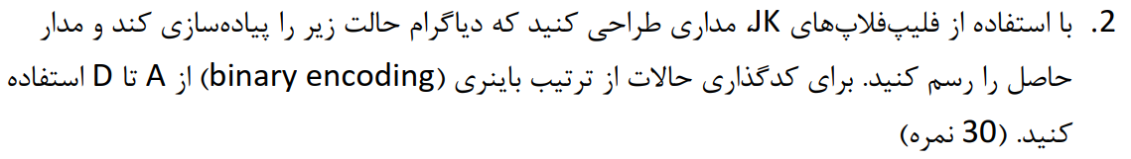
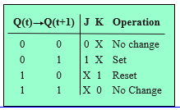
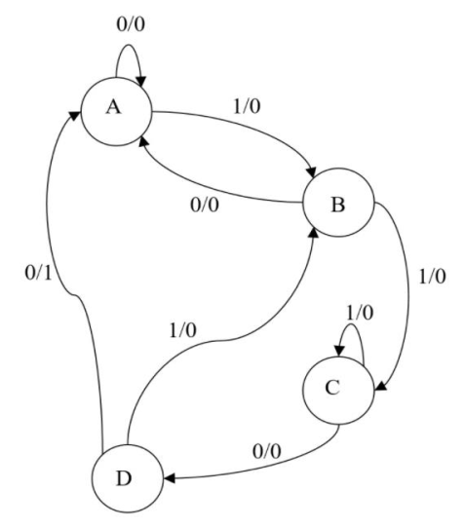
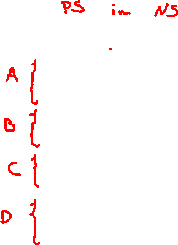
s1 | s0 | x | S1+ | S0+ | j1 | k1 | J0 | k0 | Z
0 | 0 | 0 | 0 | 0 | 0 | X | 0 | X | 0
0 | 0 | 1 | 0 | 1 | 0 | X | 1 | X | 0
0 | 1 | 0 | 0 | 0 | 0 | X | X | 1 | 0
0 | 1 | 1 | 1 | 0 | 1 | X | X | 1 | 0
1 | 0 | 0 | 1 | 1 | X | 0 | 1 | X | 0
1 | 0 | 1 | 1 | 0 | X | 0 | 0 | X | 0
1 | 1 | 0 | 0 | 0 | X | 1 | X | 1 | 1
1 | 1 | 1 | 0 | 1 | X | 1 | X | 0 | 0

Slide 4







Slide 5


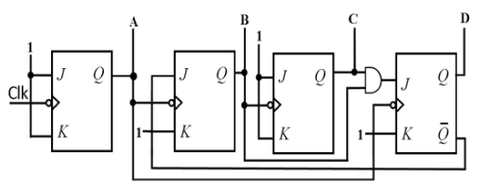
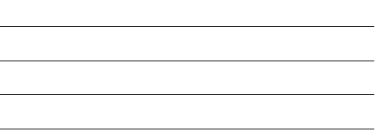

Slide 6
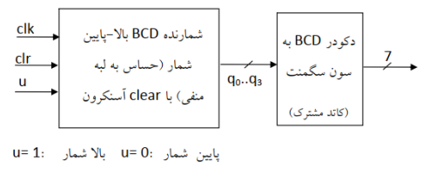



Slide 8
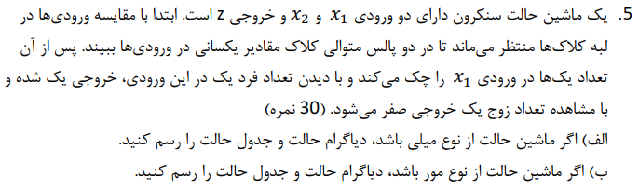










Slide 9

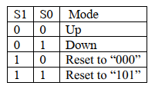



Slide 10
0 | 0 | 0 | 0 | 0 | 1 | 0 | 0 | 1
0 | 0 | 1 | 0 | 1 | 0 | 0 | 1 | 1
0 | 1 | 0 | 0 | 1 | 1 | 0 | 0 | 1
0 | 1 | 1 | 1 | 0 | 0 | 1 | 1 | 1
1 | 0 | 0 | 1 | 0 | 1 | 0 | 0 | 1
1 | 0 | 1 | 1 | 1 | 0 | 0 | 1 | 1
1 | 1 | 0 | 1 | 1 | 1 | 0 | 0 | 1
1 | 1 | 1 | 0 | 0 | 0 | 1 | 1 | 1

Slide 11
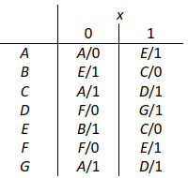


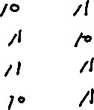



Slide 12
